Slide 1
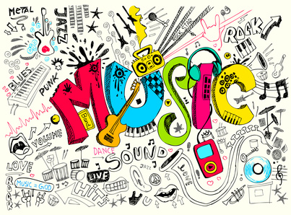
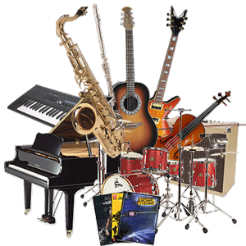
The Music Toolbox
Expresses feelings and experiences through auditory, musical and rhythmic tools (sounds).

Slide 2
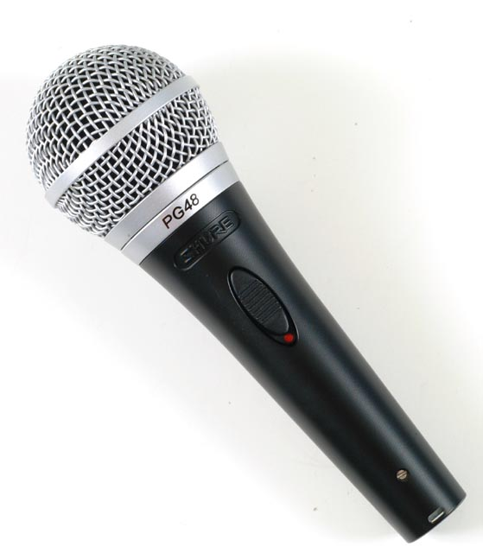
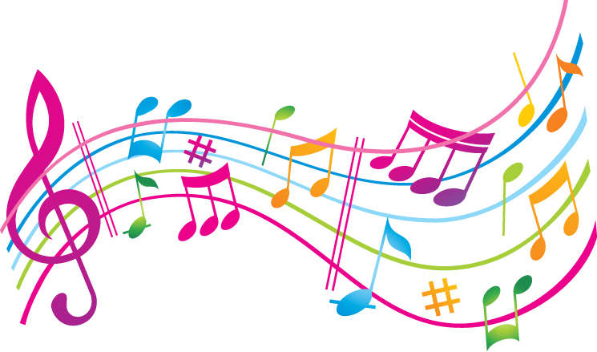
Words
The right words can turn an ordinary poem into music, are songs just a kind of poetry?

Slide 3
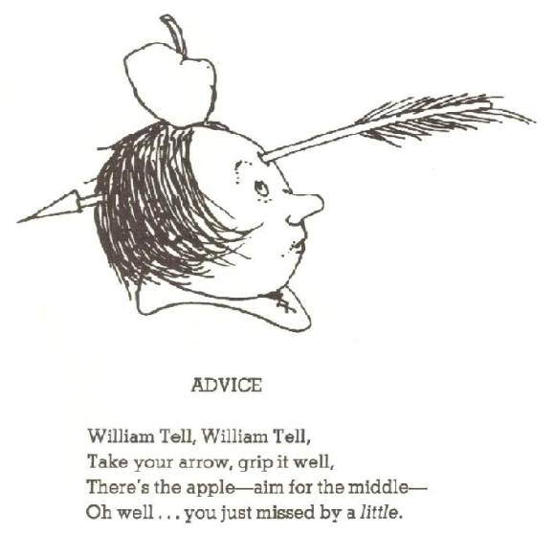
What is this poem an example of? Hint: Pay attention to the last word of each line
By Shel Silverstein

Slide 4
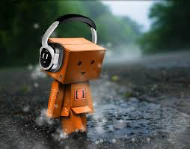
Rhyme
Rhyme Challenge to come at end of slideshow….
Cat, hat, bat, that, splat chat
Hand, canned, manned, strand
Peace, crease, police, “chess piece”
When two or more words have a similar sounding ending.
Rhyming in the middle of a line is called internal rhyme. Rhyming at the end of a line is called end rhyme.

Slide 5
Repetition/Patterns
Almost Perfect
By Shel Silverstein
“Almost perfect…but not quite.”
Repeating words, phrases, lines, or groups of words

Slide 6
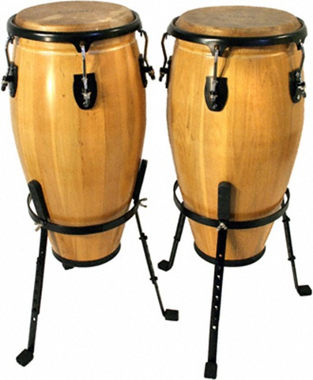
Rhythm
Mice Are Nice
By N.M. Bodecker
Mice
are nice,
and sprigs
of spice,
and jelly beans
and jingles.
Kids
are nice,
but twins
are twice
as nice, they say,
as singles.
The musical feeling of the words in a line

Slide 7
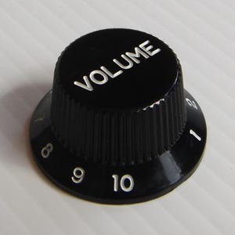
Line-Breaks
Peach
Touch it to your cheek and it's soft
as a velvet newborn mouse
who has to strive
to be alive.
Bite in. Runny
honey
blooms on your tongue—
as if you’ve bitten open
a whole hive.
Rose Rauter
An unnatural break added to a complete sentence. Line breaks can add to the beat and musical feel of a poem.

Slide 8
Onomatopoeia
Onomatopoeia Brainstorm?
2 minutes…
Words that imitate sounds, Ex. Splat! Buzz…

Slide 9
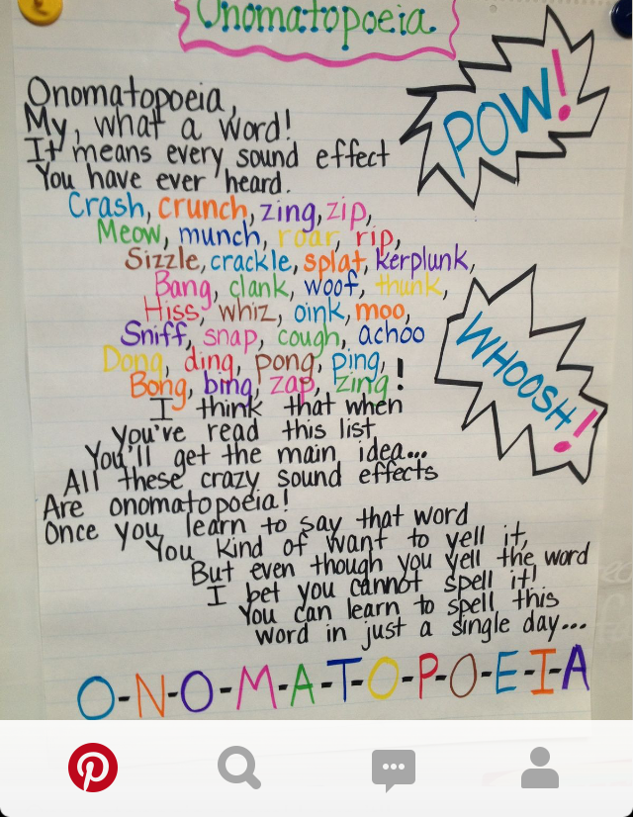

Slide 10
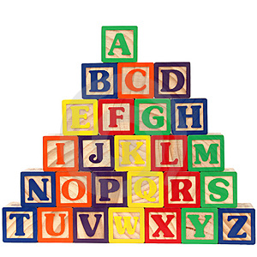
Alliteration
What is this an example of again?
"Peter Piper picked a peck of pickled peppers..."
by Mother Goose
Peter Piper picked a peck of pickled peppers;
A peck of pickled peppers Peter Piper picked;
If Peter Piper picked a peck of pickled peppers,
Where's the peck of pickled peppers Peter Piper picked?
The repetition of consonant sounds at the beginning of words.

Slide 11
What is this an example of?
Nothing Gold Can Stay
By Robert Frost
…
Her early leaf’s a flower;
But only so an hour.
…
So dawn goes down to day.

Slide 12
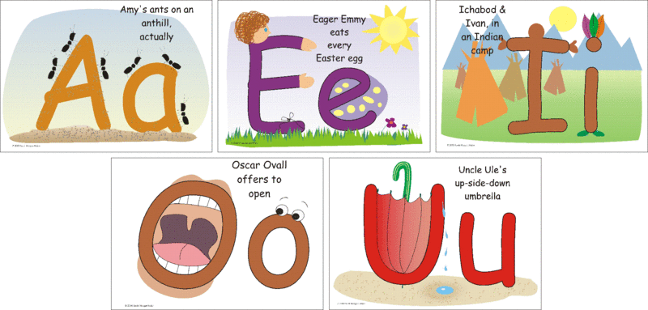
Assonance
The repetition of vowel sounds. Assonance often sounds like a rhyme

Slide 13
What is this an example of?
Out-Out
by Robert Frost
The buzz-saw snarled and rattled in the yard
And made dust and dropped stove-length sticks of wood,
Sweet-scented stuff when the breeze drew across it.
And from there those that lifted eyes could count
Hint…

Slide 14
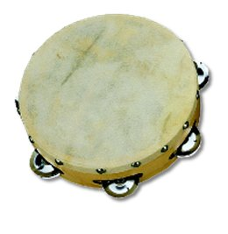
Consonance
The repetition of consonant sounds. Similar to alliteration but the sounds do not have to be at the beginning of words.

Slide 15
Rhyme Challenge!
Try to find rhymes to these words:
Tangerine
Thunder
Television
Saskatchewan
Hippopotamus
Orange

Slide 16
Some possible rhymes…
Tangerine: trampoline, serene, marine, caffeine, mean, queen, keen, green, cuisine, routine, teen, lean…
Television: revision, vision, precision, division
Almost rhymes…suspicion, definition
Thunder: wonder, plunder, blunder
Almost rhymes…number, slumber, runner
Saskatchewan: lawn, dawn, gone, prawn, leprechaun
Almost rhymes…belong, singsong, strong, wrong
Hippopotamus: Almost rhymes…metropolis, esophagus, zoologist, novelist
Orange: No perfect rhyme for…door hinge?

