Slide 1
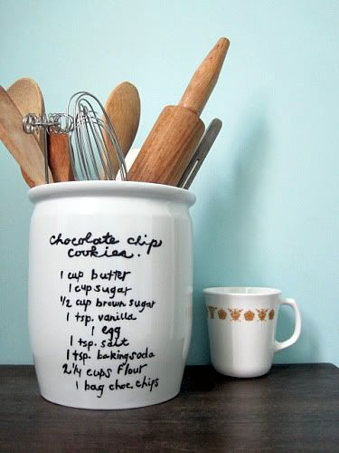
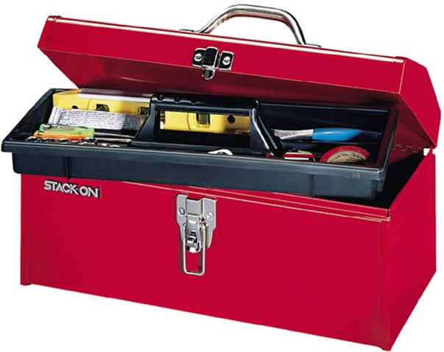
The Meaning Toolbox
Expresses feelings and experiences through visual and sensory (smell, hearing, taste, feel) tools. Also includes revision/drafting tools

Slide 2
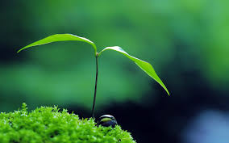
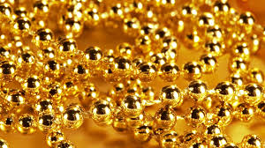
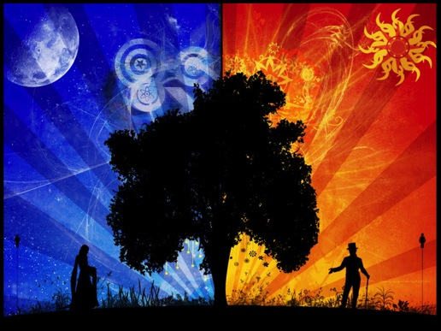
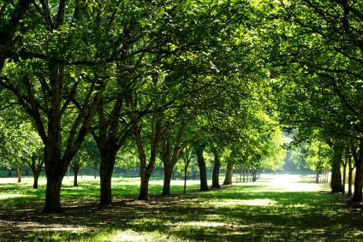
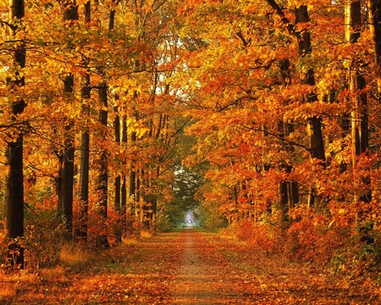
Nothing Gold Can Stay
By Robert Frost
Nature’s first green is gold,
Her hardest hue to hold,
Her early leaf’s a flower;
But only so an hour.
Then leaf subsides to leaf.
So Eden sank to grief,
So dawn goes down to day.
Nothing gold can stay.

Slide 3
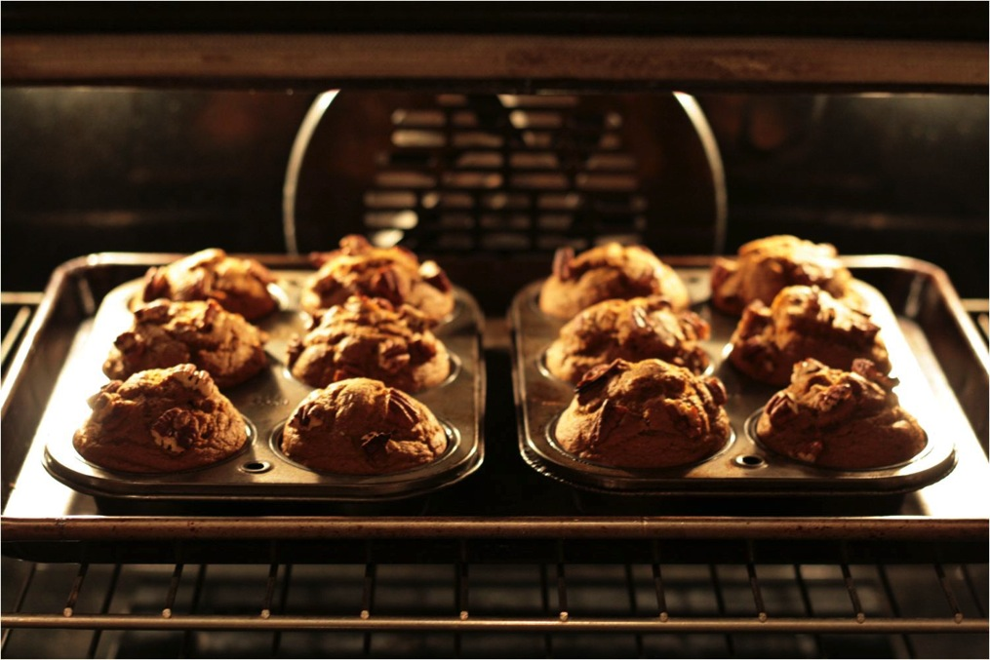
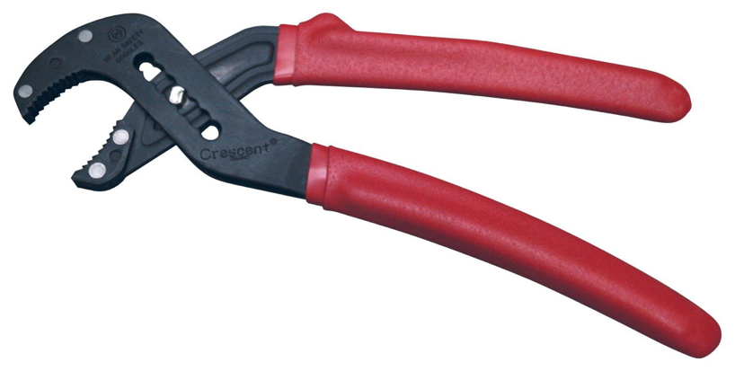
Image
A picture in your mind that holds feelings, memories, ideas, or inspiration. Poetry is often about letting these

Slide 4
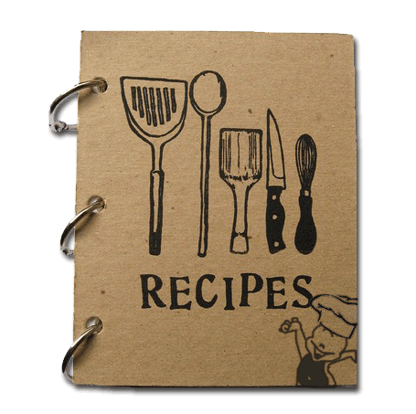
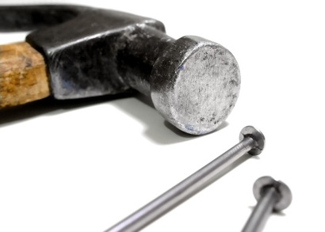
Words
Words are the power to make something happen. Well chosen and powerful words can make

Slide 5
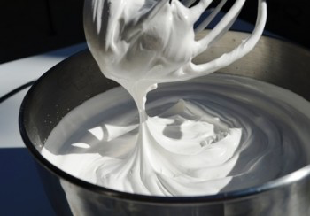
Observation
Using your senses to notice the details

Slide 6
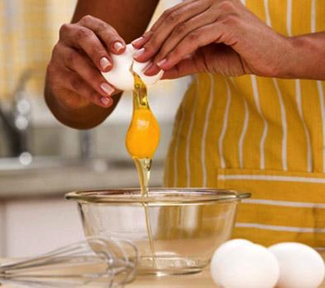
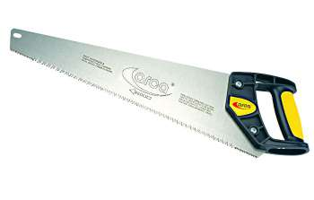
Line - Break
An unnatural break added to a complete sentence

Slide 7
Example of Line Breaks
Porch Light
By Debroah Chandra
At night
the porch light
catches moths
and holds them
trapped
and flapping
in a tight
yellow fist.
Only when I
turn the switch
will it loosen
its hot
grip.
First sentence ends here
Second sentence ends here

Slide 8
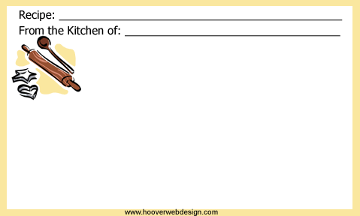
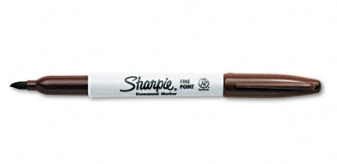
Titles
Cookies
Vs.
Chewy Chocolate Chip Cookies
The name of a poem. The title gives a reader his/her first impression of the poem.

Slide 9
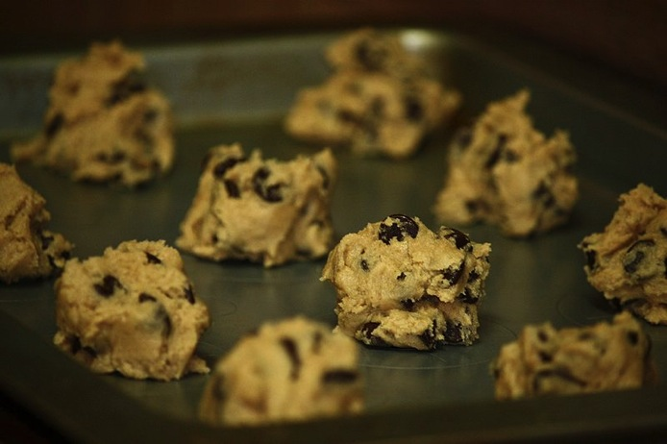
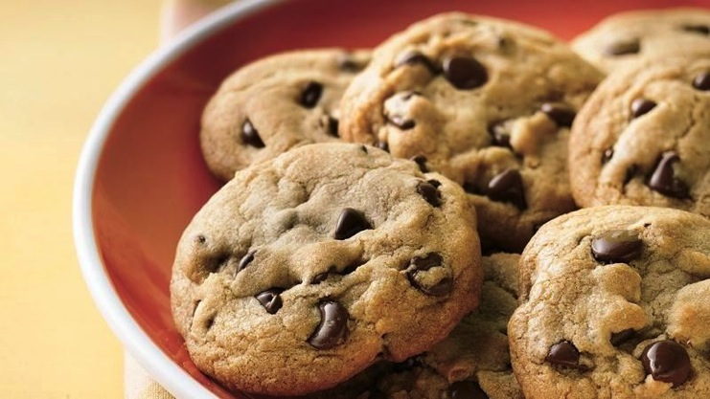
Beginnings/Endings
The entrance and exit of a poem. Just as important as introductions and conclusions in essay writing

Slide 10
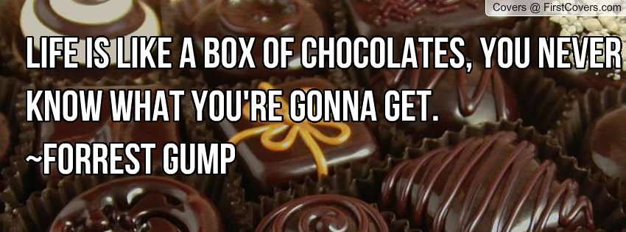
Simile
The comparison of two unlike things using “like” or “as”

Slide 11
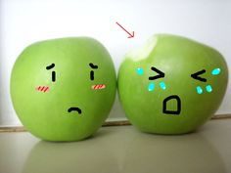
Personification
To give human characteristics or traits to nonliving things

Slide 12
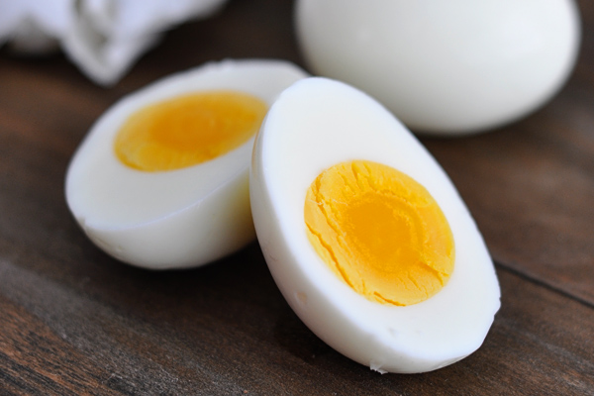
Metaphor
A box without hinges, key, or lid,
yet golden treasure inside is hid.
From The Hobbit by J.R.R. Tolkien
Figure of speech meaning the comparison of two unlike things

Slide 13
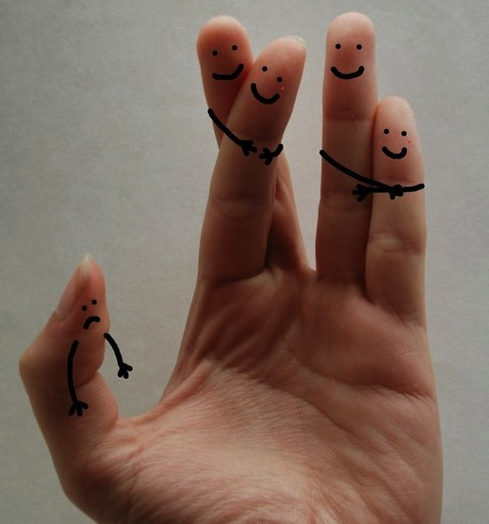
Metaphor Guessing Game
____________________ by Philip Dacey
The odd, friendless boy raised by four aunts.
Answer: Thumb

Slide 14
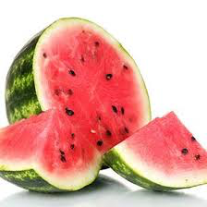
Metaphor Guessing Game
____________________ by Charles Simic
Green Buddhas
On the fruit stand.
We eat the smile
And spit out the teeth.
Answer: Watermelon

Slide 15
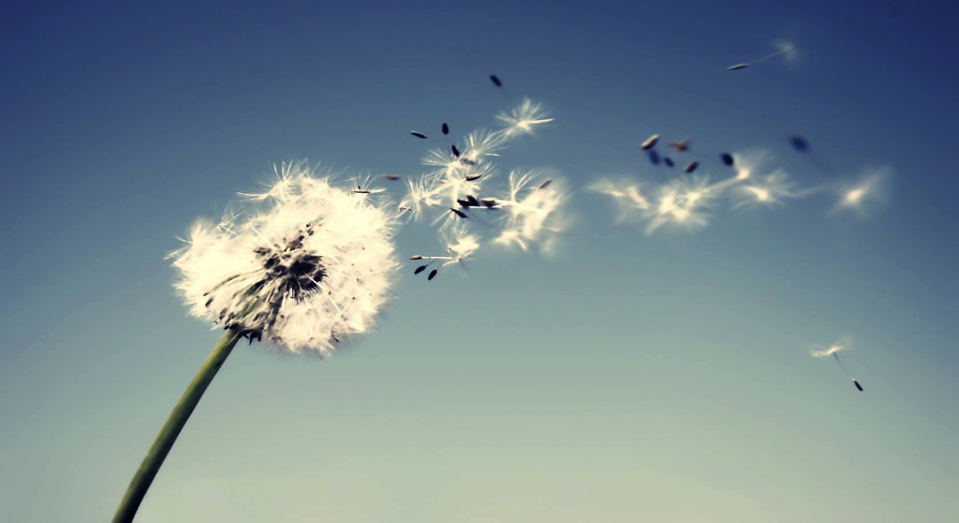
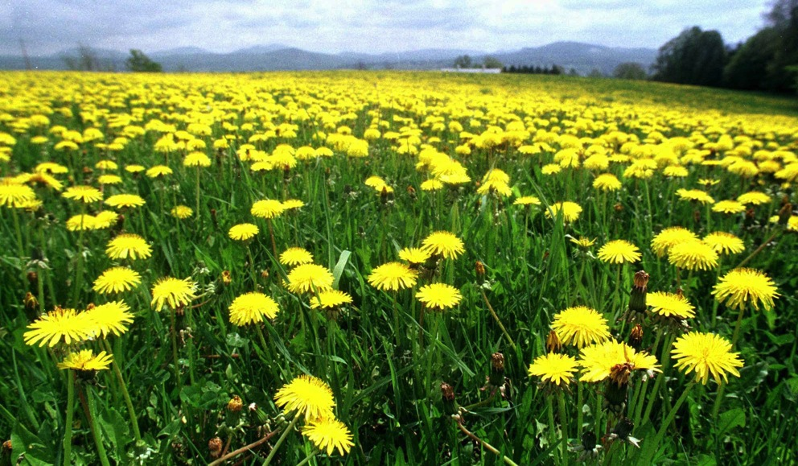
Metaphor Guessing Game
____________________ by Valerie Worth
Out of
Green space,
A sun:
Bright for.
A day, burning
Away to
A husk, a
Cratered moon:
Burst
In a week
To dust:
Seeding
The Infinite
Lawn with
Its starry
Smithereens
Answer: Dandelions

