Slide 1
Heart Door
Notes:
Writing about our inner lives, it’s about our feelings, what matters to us, our dreams, love, anger, sadness

Slide 2
Observation Door
Notes:
Observation Door – Connecting to your senses: what is it that you see, hear, feel, smell, taste? The world is bursting with beauty (and disgust), so take note of it by walking through this door

Slide 3
Concerns About the World Door
Notes:
Concerns about the World Door – Not all poetry is about love and pretty things. Here is where you walk into the real world, and find the words to express what you care about: war, climate change, homelessness

Slide 4
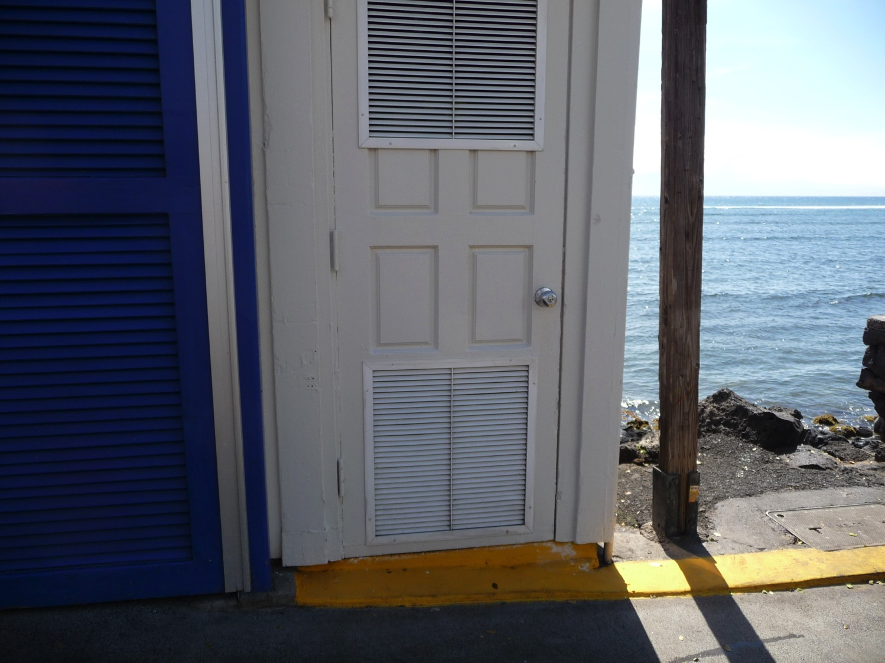
Wonder Door
Notes:
Wonder Door – This door we should be used to. Inquiry, curiosity…what happens when we die? Why’s the sky blue? What do you wonder? Walk through and find out.

Slide 5
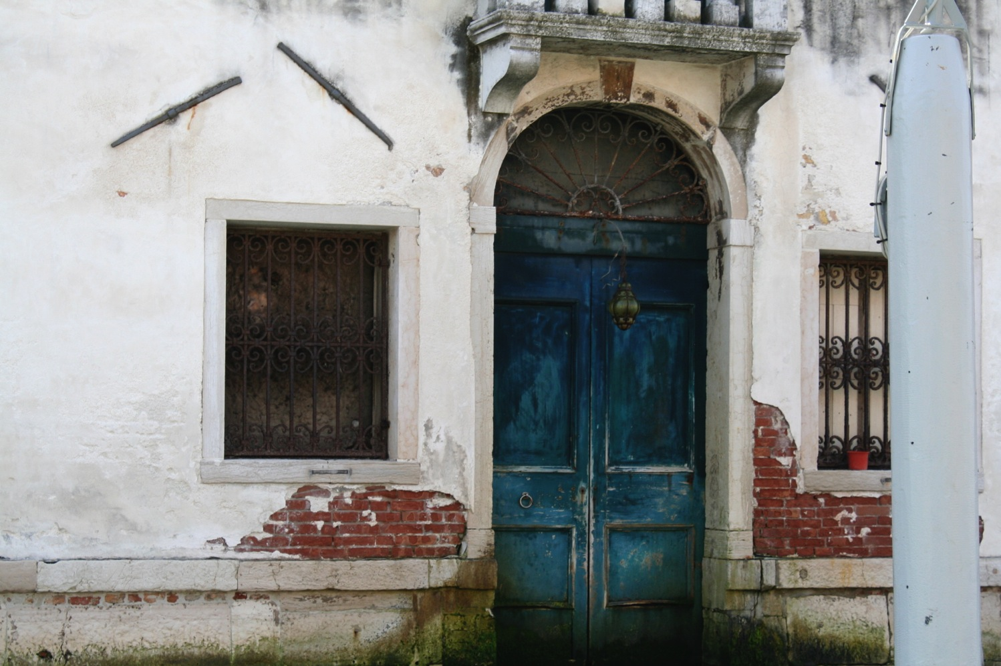
Memory Door
Notes:
Memory Door – Travel back in time with the turn of this door knob, look back on your memories. Find the words to share with the world your past.

Slide 6
Endless Possibilities Door
Notes:
Endless Possibilities Door – Just as the universe is infinite, so too are the possibilities in poetry, from humour, to self-reflection, to predicting the future, anything is possible.

