Slide 1
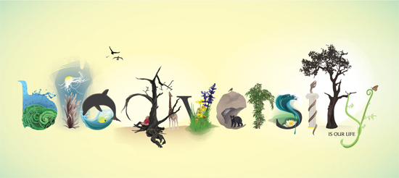
Biodiversity of Life
Adapt
Or Die!
http://www.noupe.com/inspiration/a-showcase-of-artistic-typography.html

Slide 2
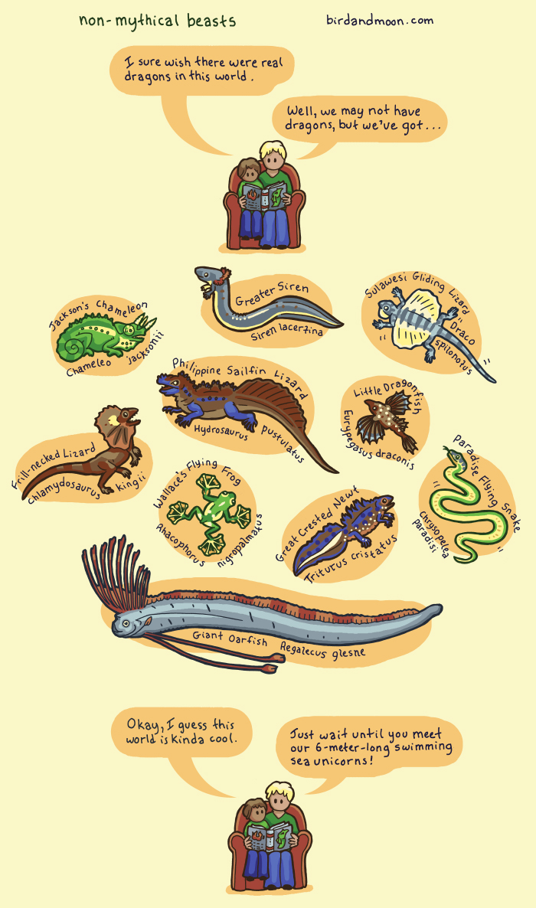
Notes:
There are so many mythical creatures and imagined animals, but there is such a great diversity in the real world that is so much more exciting to explore.

Slide 3
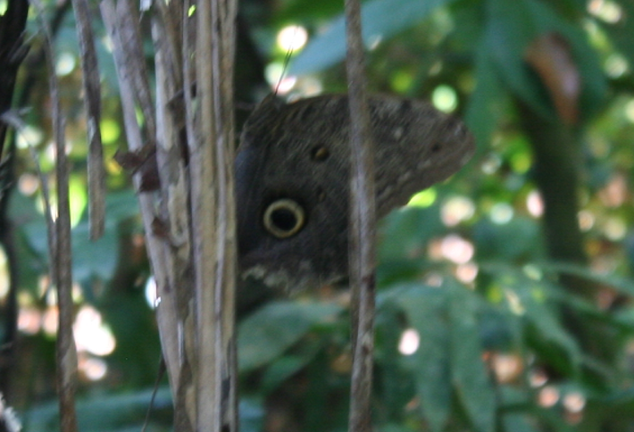
Characteristics of Life (pg. 43)
Biodiversity (pg. 41)
I CAN list and describe the levels of biodiversity
I CAN list and describe the characteristics of life
Butterfly or owl? What do you think? ☺

Slide 4
Biodiversity (pg. 41)
Biodiversity is the variety of all living things in an environment, from giant redwood trees to microscopic, single celled algae
Scientists have identified ~1.75 million different species, including about:
1,000,000 species of insects
300,000 species of plants
30,000 species of fish
10,000 species of birds
5,500 species of mammals
National Geographic; Issue21
Notes:
Habitat loss affects 85% of all species threatened with extinction
Between 200 & 2,000 species become extinct every year → According to World Wildlife Foundation, the earth has lost 40% of its wildlife in the last 40 years

Slide 5
Five Kingdoms of Life
10 Brain bumps!
10th one answer: what are the 5 kingdoms?
http://anthropophobia.hubpages.com/hub/The-Five-Kingdoms
Notes:
Kingdom Animalia
Kingdom Plantae
Kingdom Fungi
Kingdom Protista
Kingdom Monera

Slide 6
Alive or Not? (2:00)
Notes:
Youtube Clip of “dancing oobleck”: https://www.youtube.com/watch?v=2CJJ6FrfuGU

Slide 7
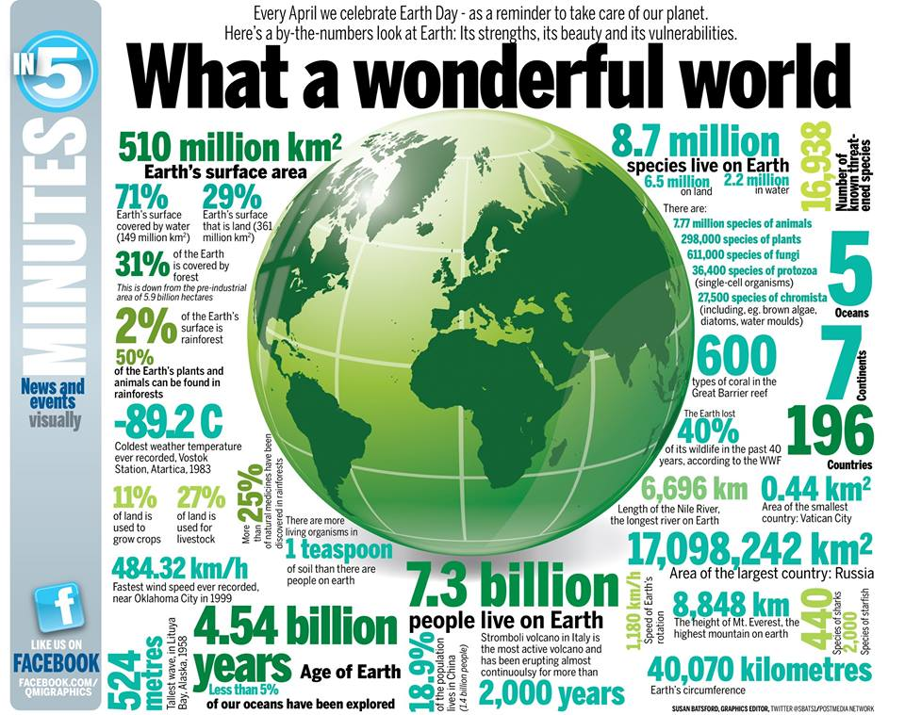
Brainstorm (pg. 42)
What criteria can you come up with that allows you to decide whether something is a living or non-living thing?

Slide 8
Alive or Not? (pg. 42) (Time - 3:00)
Notes:
Alive or Not Video: http://www.pbslearningmedia.org/resource/tdc02.sci.life.colt.alive/is-it-alive/

Slide 9
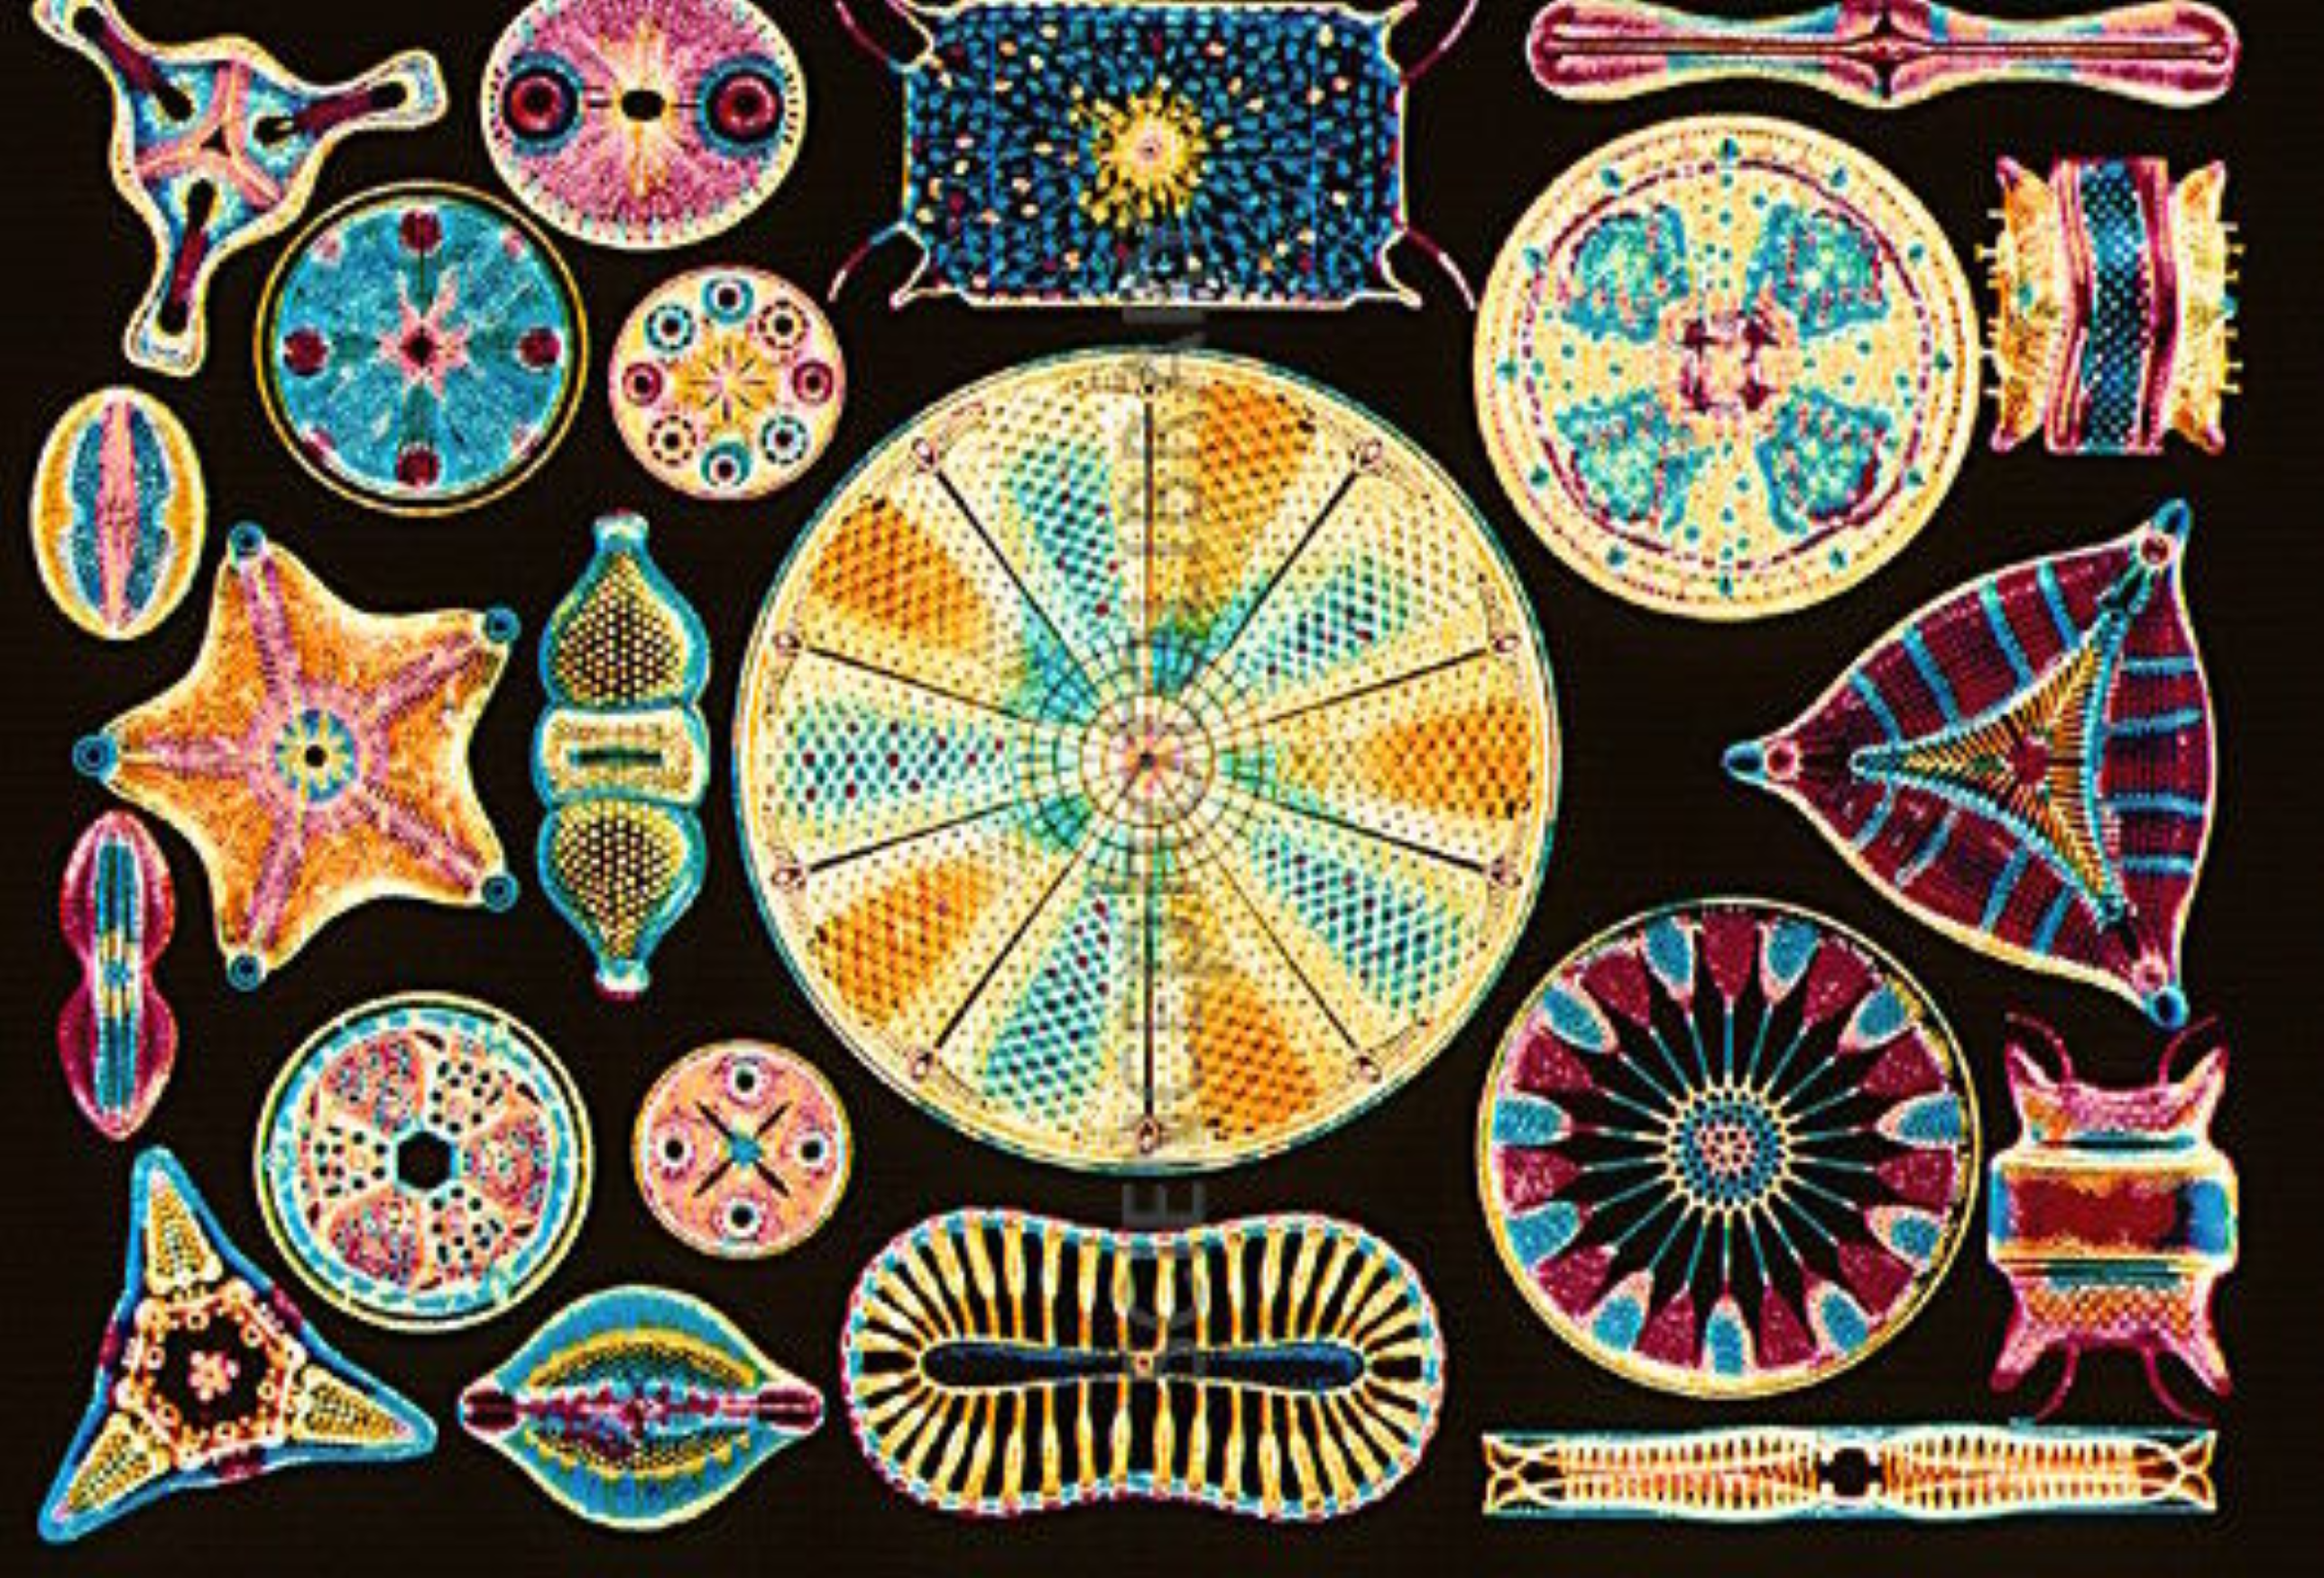
Characteristics of Life (pg. 41)
Class Brainstorm: How did your criteria change? How can we decide if something is a living or non-living thing?
Ernst Haeckel's: "Art Forms of Nature" (1904).
Notes:
living things have highly organized, complex structures (CELLS); 2) living things maintain a chemical composition that is quite different from their surroundings (HOMEOSTASIS); 3) living things have the capacity to take in, transform, and use energy from the environment (METABOLIZE); 4) living things can respond to stimuli (RESPOND); 5) living things have the capacity to reproduce themselves (REPRODUCE); 6) living things grow and develop (GROW); and 7) living things are well-suited to their environment (ADAPT)
Picture is of diatoms → single, celled algae; defining characteristic of diatoms are their intricately patterned, glass like cell walls & this structure is called the “frustale”, which shows a great diversity within the species; diatoms form an important part of marine food chains, they are primary producers (use light to help make their own food)
Diatoms occur in every environment where there is water → from the ocean to lakes to even soil; they play an important role in the world’s carbon cycle (as they, like plants, use CO2 to metabolize)

