Slide 1
Biodiversity of Life
Adapt
Or Die!
http://www.noupe.com/inspiration/a-showcase-of-artistic-typography.html

Slide 2
Setting up our notebooks:
pg. 34 → Table of Contents
pg. 35 → Learning Map Title Page
pg. 37 → Learning Map “I CAN…” Statements
pg. 39 → Circle Diagram

Slide 3
Video #1
Classification of Living Things (2:30 min)

Slide 4
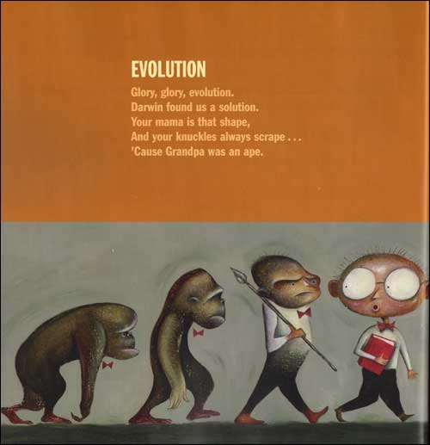
What do you re-member
about living things? (pg. 36)
Notes:
How do you know something is alive?
What do living things do?
What the different “types” of living things? Groupings?
Names of Groupings?

Slide 5
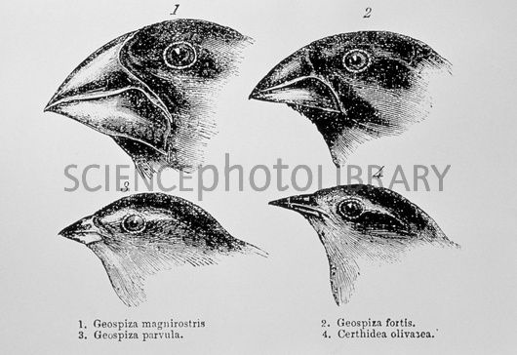
Circle and Define (pg. 36-37)
Circle all the Key Words that are familiar to you.
Define, using your own words, what you think your circled words mean.

Slide 6
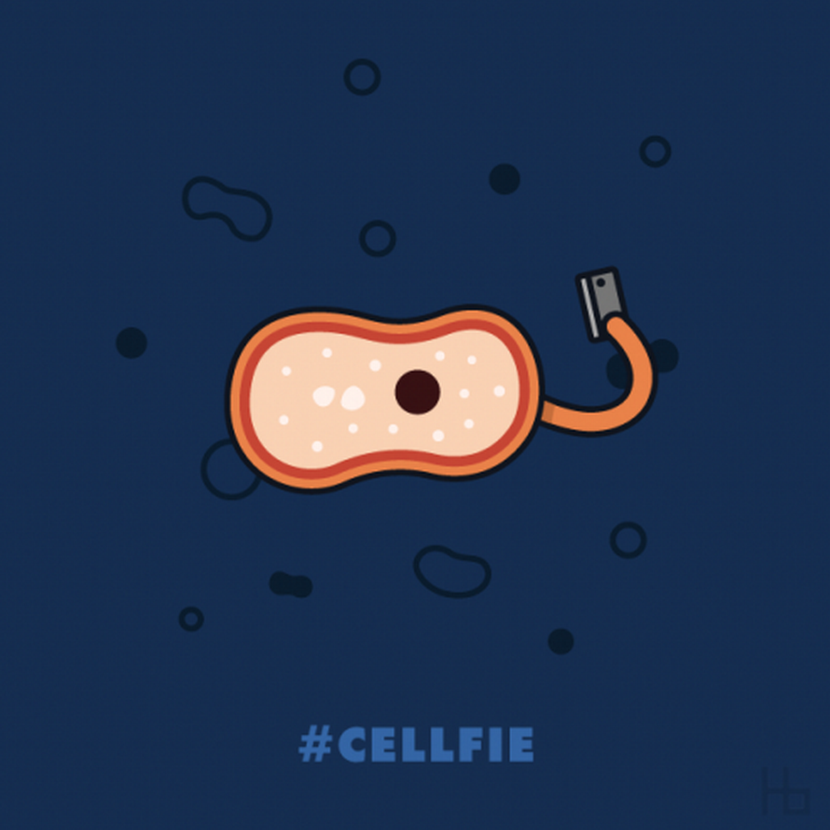
My Questions & Wonders (pg. 35)
What are you most curious to learn about living things?

Slide 7
Agree or Disagree (pg. 36)
Bacteria are living things.
Mushrooms are a specialized kind of plant.
All brightly coloured living things have a hard time hiding. This makes them poorly adapted.
Biodiversity includes all living things.
Hibernation is an adaptation to help living things survive when there is not enough food.

Slide 8
Five Kingdoms of Life (pg. 39)
Learning Intention: I CAN list & describe the 5 Kingdoms
http://anthropophobia.hubpages.com/hub/The-Five-Kingdoms

Slide 9
Video #2
Characteristics of the 5 Kingdoms (3:50 min)

Slide 10
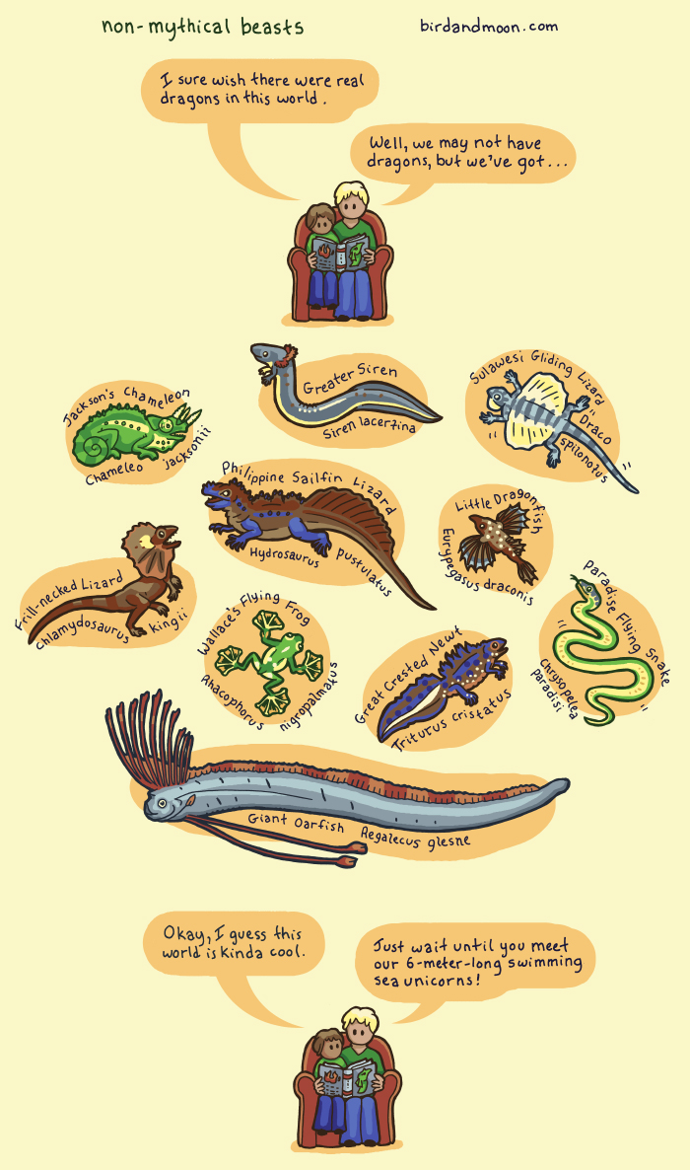

Slide 11
The 5 Kingdoms (pg. 38-39)
Research and describe the key characteristics of each kingdom
Give examples of organisms that are in each kingdom
The 5 kingdoms are: Monera, Protista, Fungi, Plant, Animal

Slide 12
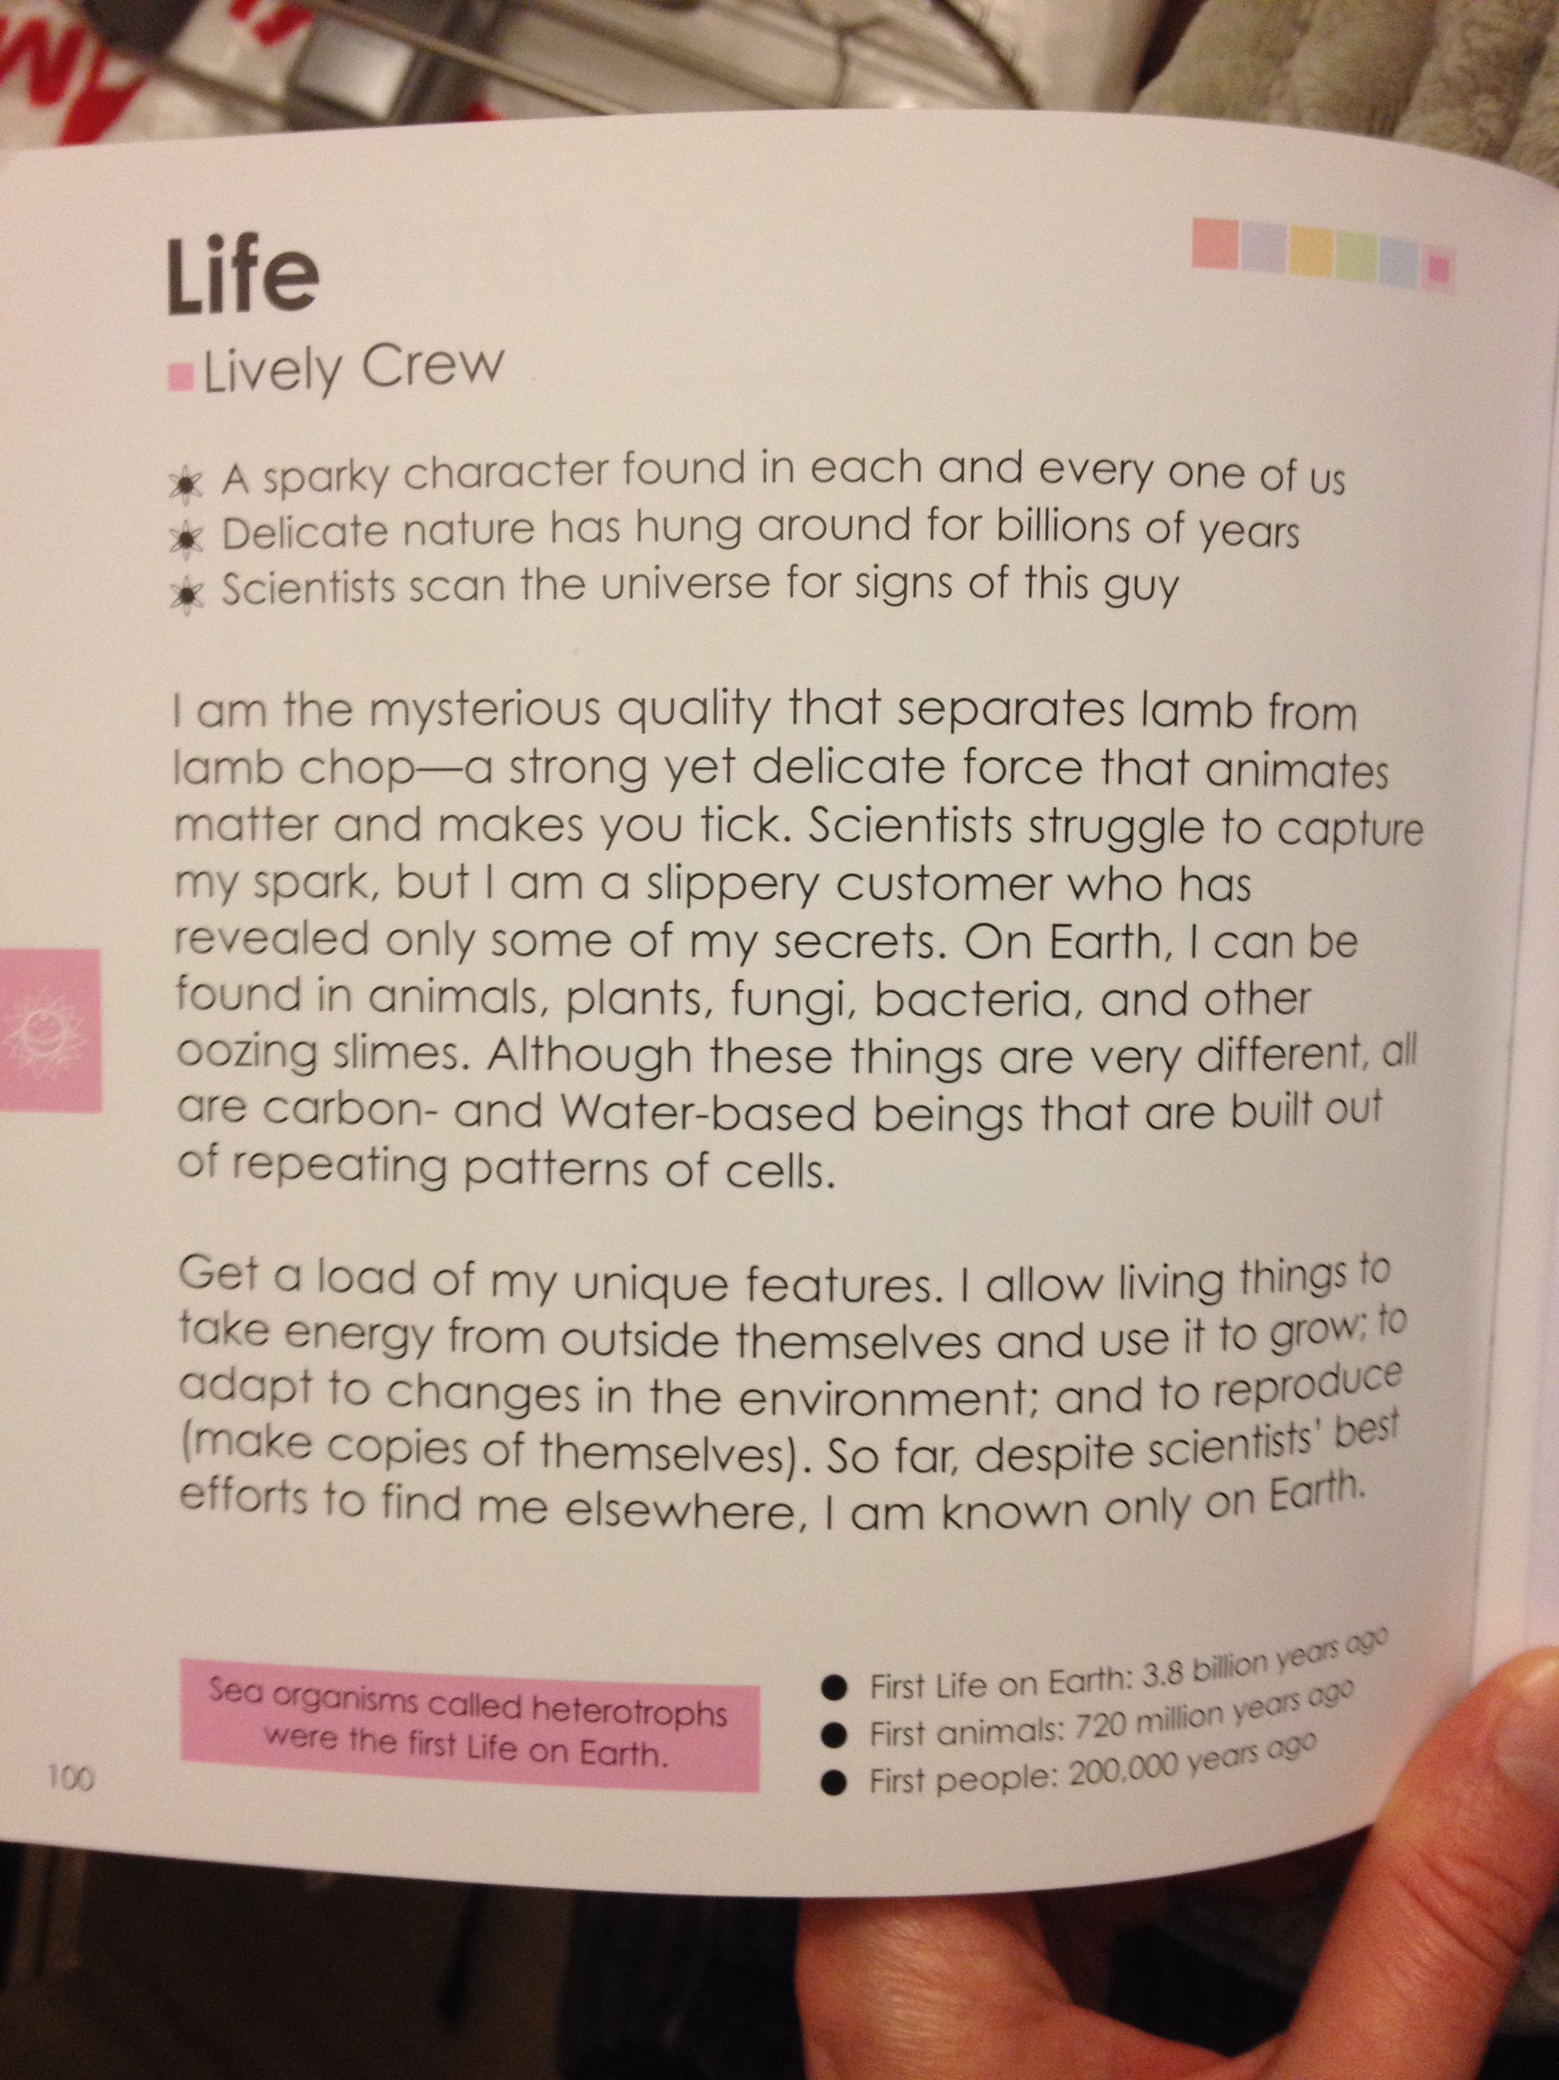
Visual Example of Demonstrating your Learning
“Planet Earth” by Dan Gilpin

